Slide 1

X-Containers: Breaking Down Barriers to Improve Performance and Isolation of Cloud-Native Containers
Zhiming Shen
Cornell University
Joint work with Zhen Sun, Gur-Eyal Sela, Eugene Bagdasaryan, Christina Delimitrou, Robbert Van Renesse, Hakim Weatherspoon

Slide 2
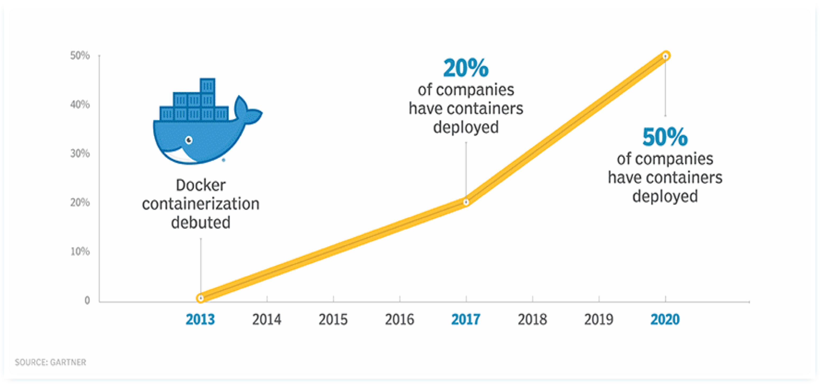
Software Containers
2

Slide 3
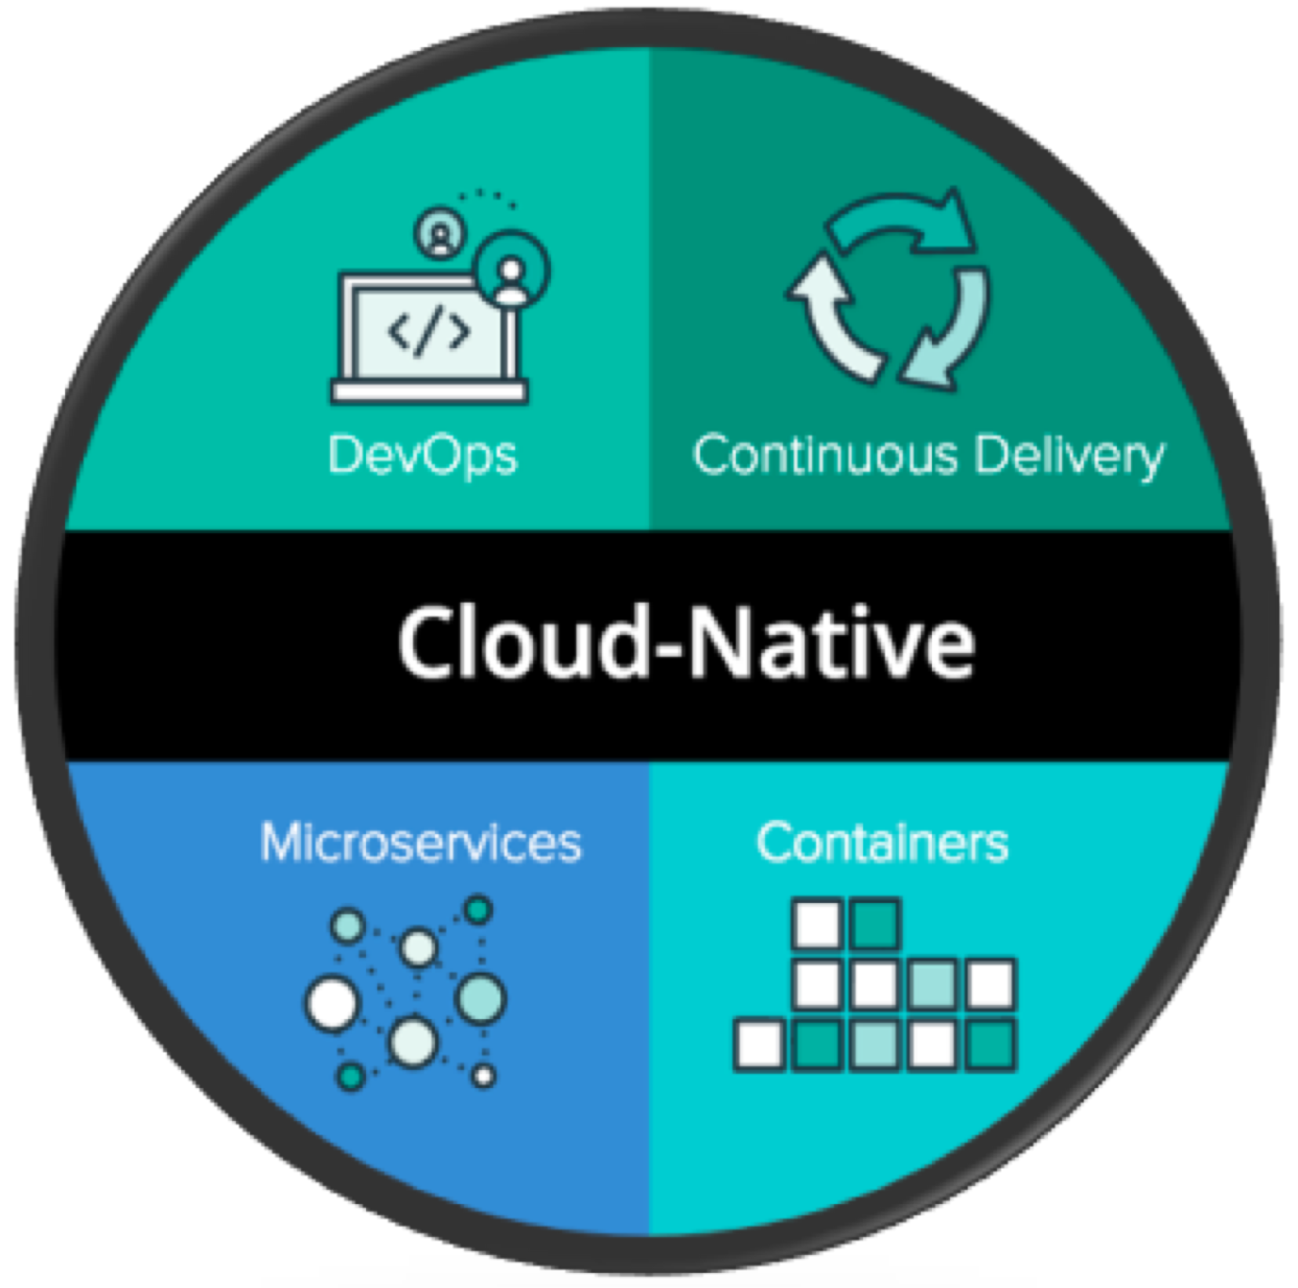
Cloud-Native Container Platforms
Img src: https://pivotal.io/cloud-native
3

Slide 4
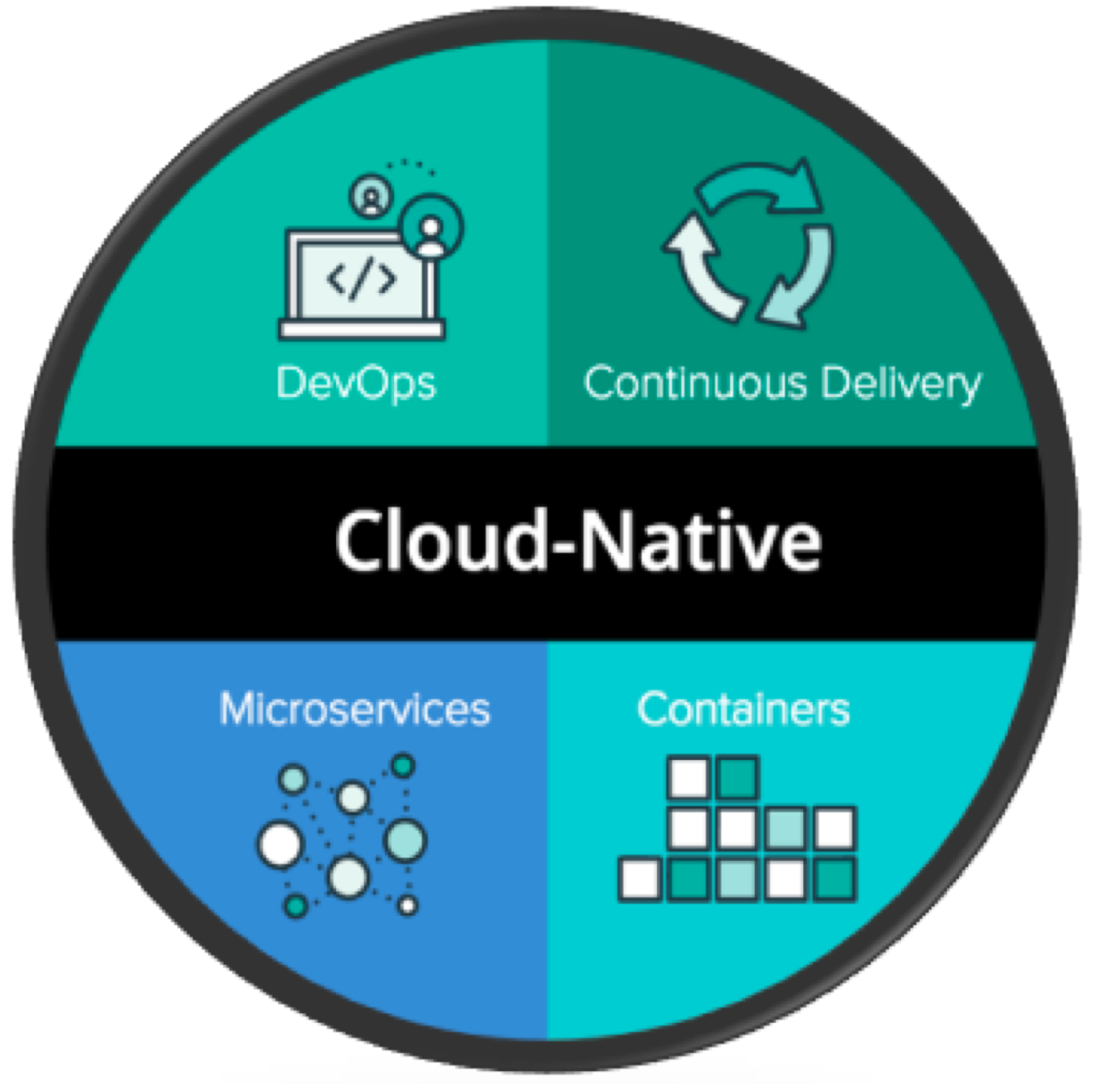
Cloud-Native Container Platforms
Single Concern Principle:
Every container should address a single concern and do it well.
Making containers easier to
Replace, reuse, and upgrade transparently
Scale horizontally
Debug and troubleshoot
Img src: https://pivotal.io/cloud-native
4
Notes:
Kubernetes等“原生云”容器平台已成为生产云环境不可或缺的一部分。
在云原生平台中，容器设计类似于面向对象软件系统中的对象设计，每一个容器都应该解决一个问题，并且把这一个问题解决好。在面向对象语言中被称为“单一职责原则”，在云原生中被称为“单一关注原则”。

Slide 5
The Problem
Not allowed to install kernel modules
Process
Process
Process
Process
Shared kernel attack surface and TCB
Container
Container
namespaces cgroups
Linux Kernel
Hardware
SELinux
Hard to tune or optimize for a specific container
Notes:
但在一个主机上运行多个容器可能会带来许多安全隐患。
由于Linux内核和内核攻击面被所有容器共享，通常不允许容器安装自己的内核模块，这对需要内核自定义的应用程序造成限制。
且因为内核已经与其它容器共享，也无法轻松地针对特定容器进行优化和改进。

Slide 6
Existing Solutions
Isolation Customization Optimization
Portability Performance
VM
Process
Process
Container
Container
Process
Process
Linux
KVM
Linux
Clear Container
gVisor
Process
Process
Linux
Container
Linux
gVisor
Require nested hardware virtualization support in the cloud
Ptrace mode: high overhead
KVM mode: require nested virtualization

Slide 7
X-Containers achieve
VM-level Isolation
Support of Kernel Customization
Support of Kernel Optimization
Good Portability (without the need of hardware-assisted virtualization)
High Performance
AND
Backward Compatibility

Slide 8
X-Containers
Container
Container
Process
Process
Process
Process
User mode
Kernel mode
OS Kernel

Slide 9
X-Containers
Container
Container
Process
Process
Process
Process
User mode
OS Kernel
OS Kernel
Kernel mode
Exokernel

Slide 10
X-Containers
Container
Container
Process
Process
Process
Process
OS Kernel
OS Kernel
User mode
Kernel mode
Exokernel

Slide 11
X-Containers
X-Container
X-Container
Process
Process
Process
Process
X-LibOS
X-LibOS
User mode
Kernel mode
X-Kernel

Slide 12
X-Containers
A new security paradigm for cloud-native containers
VM
Process
Process
X-Container
Container
Container
Process
Process
Process
Process
Linux
KVM
Linux
Clear Container
gVisor
Process
Process
X-LibOS
X-Kernel
X-Container
Linux
Container
Linux
gVisor
X-Kernel: an exokernel with a small attack surface and TCB
X-LibOS: a LibOS that decouples security isolation from the process model
Notes:
提出了X-Container
容器间隔离由X-Kernel解决，exokernel可以确保小的攻击面和可信计算基础（TCB）
每个单一关注的容器运行自己的X-LibOS，可以支持多进程以保证并发性和兼容性，但并不对安全起作用。

Slide 13


Threat Model and Design Trade-offs
Threat model
X-Container
X-Container
X-Container
Process
Process
Process
Process
Process
Process
X-LibOS
X-LibOS
X-LibOS
X-Kernel
Trade-offs
Reduced intra-container isolation
Improved inter-container isolation and performance
Process isolation and kernel-supported security features are not effective
Notes:
X-Container做了一个折衷，为提高性能和容器间隔离，大大减少了容器内的隔离。

Slide 14


Implementation
X-LibOS from Linux kernel
Binary compatibility
Highly customizable
X-Kernel from Xen
Para-virtualization interface
Concurrent multi-processing
Limitations
Memory management
Spawning time
X-Container
X-Container
X-Container
Process
Process
Process
Process
Process
Process
User mode
X-LibOS
X-LibOS
X-LibOS
Kernel mode
X-Kernel

Slide 15

Optimizing System Calls
Existing solutions
Patch source code
Link to another library
Our solution
Automatic Binary Optimization Module (ABOM)
Binary level equivalence
Position-independence
System calls
X-Container
Function calls
Process
Process
User Mode
X-LibOS
Kernel Mode
X-Kernel
For many applications, more than 90% of syscalls are turned into function calls

Slide 16
Evaluation Setup
Testbed
Amazon EC2
Google Compute Engine
Compared container runtimes
Docker
gVisor (Ptrace in Amazon, and KVM in Google)
Clear-Container (only in Google)
Xen-Container
X-Container
Configurations
Patched for Meltdown

Slide 17



System Call Performance
Up to 27X of Docker (patched) and
30
25
1.6X of Clear-Container
Normalized Performance
20
15
10
5
0
Amazon
Clear-Container
Google
Xen-Container
Docker
gVisor
X-Container

Slide 18






















Real Application Performance
NGINX
1.5
1
0.5
0
1.21x~1.27x
Memcached
2.64x~3.08x
4
Normalized Throughput
2
0
Amazon Google
Amazon
Google
Redis
1.5
1
0.5
0
Apache
1.5
1
0.5
0
1x~1.2x
0.64x~0.72x
Amazon Google
Amazon Google

Slide 19
Spawning Time and Memory Footprint
Spawning Time
Memory Footprint
5
30
4
0.29
Memory Footprint (MB)
25
0.28
2.10
3.66
20
8.80
3
Free
X-LibOS
Extra micropython
Time (S)
User Program
X-LibOS Booting Xen Tool Stack
15
2
11.16
10
1
5
0.29
0.56
0.28
3.56
0
0.46
0
1.00
1.93
Docker
X-Container
X-Container'
Docker
X-Container
Reduced to 460ms.
Can be further reduced to <10ms.
19

Slide 20
More Evaluations in the Paper
More micro/macro benchmarks
Patched and unpatched for Meltdown
Comparing to Unikernel and Graphene
Scalability (up to 400 containers on a single host)

Slide 21
Conclusion
X-Containers: a new security paradigm for isolating single-concerned cloud-native containers
X-Kernel: an exokernel with a small attack surface and TCB
X-LibOS: A LibOS that decouples security isolation from the process model
Trade-off: intra-container isolation vs. inter-container isolation
Implemented with Xen and Linux
Binary compatibility
Concurrent multi-processing
More at http://x-containers.org
Thank You. Questions?

Slide 22
Backup Slides

Slide 23
Pros and Cons of the X-Container Architecture
 | Container | gVisor | Clear-Container | LightVM | X-Container
Inter-container isolation | Poor | Good | Good | Good | Good
System call performance | Limited | Poor | Limited | Poor | Good
Portability | Good | Good | Limited | Good | Good
Compatibility | Good | Limited | Good | Good | Good
Intra-container isolation | Good | Good | Good | Good | Reduced
Memory efficiency | Good | Good | Limited | Limited | Limited
Spawning time | Short | Short | Moderate | Moderate | Moderate
Software licensing | Clean | Clean | Clean | Clean | Need discussion

Slide 24
Comparing Isolation Boundaries
VM
X-Container
VM
Process
Container
Process
Process
Process
LibOS
Process
Process
Process
Process
LibOS
X-LibOS
Process
Kernel
L4Linux Process
Microkernel
L4Linux (Microkernel)
Kernel Process
Kernel Container
Hypervisor
Virtual Machine
Hypervisor
Unikernel, Dune, EbbRT, OS^{v}
Exokernel
Library OS (Exokernel)
X-Kernel
X-Container

Slide 25
Automatic Binary Optimization Module (ABOM)
00000000000eb6a0 < read>:
eb6a9: | b8 | 00 00 00 00 | mov | $0x0,%eax
eb6ae: | 0f | 05 | syscall
7-Byte Replacement (Case 1)
00000000000eb6a0 < read>:
eb6a9: ff 14 25 08 00 60 ff
callq
*0xffffffffff600008
000000000007f400 < syscall.Syscall>:
7f41d: 7f422:
48 8b 44 24 08
0f 05
mov syscall
0x8(%rsp),%eax
7-Byte Replacement (Case 2)
000000000007f400 < syscall.Syscall>:
7f41d: ff 14 25 08 0c 60 ff callq *0xffffffffff600c08
0000000000010330 < restore_rt>:
9-Byte Replacement (Phase-1)
0000000000010330 < restore_rt>:
9-Byte Replacement (Phase-2)
0000000000010330 < restore_rt>:
10330: | 48 | c7 c0 0f 00 00 00 | mov | $0xf,%rax
10337: | 0f | 05 | syscall
10330: | ff | 14 25 80 00 60 ff | callq | *0xffffffffff600080
10337: | 0f | 05 | syscall
10330:
10337:
ff 14 25 80 00 60 ff callq *0xffffffffff600080 eb f7 jmp 0x10330
25

Slide 26
The Exokernel Approach
Separating protection and management
Process Library OS
Process Library OS
Process
Process
Operating System Kernel
Exokernel
Hardware
Monolithic OS Kernel
Hardware
Exokernel
26

